Slide 1
What is available in the training KIT to help you share knowledge further in your own communities
Ertugrul CIMEN
MEF University Library
PROJECT NUMBER 2020-1-IT02-KA226-HE-095624 CUP NUMBER B65F21000120006
Resource Sharing: A Key Pillar of Open
HERMES final conference
April 18th -19th 2023 @ The Hague

Slide 2
What is Training KIT?
Notes:
During my presentation, I will explain the content of the training kit. The training kit is composed of a set of training materials used during all the training activities.
It was stated in the HERMES project document that customized content would be prepared for two different target groups. There were librarians and library professionals in Target Group C1, and researchers, students, and teachers were in target group C2. It was planned to include seven bibliographies, seven infographics, digital maps, and seven video recordings in the content of this training kit.
Of course, we were expecting to get some impacts from the training activities using the training content, and we can list them as follows.
Expected impacts:
- developed information-seeking and retrieval competencies for all trainees using the training materials
- increased number of librarians, teachers, researchers, and students of universities and research organizations aware of Resource Sharing principles and practices
- increased number of online free and open professional training courses always available for librarians
- increased number of online free and open Information Literacy trainings always available for the whole scientific community
- online openly available lesson plans, educational materials, and assessment tools.
The transferability potential of this output is connected with the possibility of translating the video-recorded sets of webinars into other languages: the project foresees subtitles in Italian,
Spanish, Arabic, and Turkish, but the English scripts will be available worldwide to any other interested organization.
As of today, there is much more content in the training kit than intended. I will give detailed information about these in the following slides.
Before moving on to the new slides, I would like to thank the committee members and trainers I worked with on the Training Committee. However, special thanks to Stefania, who prepared an excellent project document for us; Carmen, who designed the questionnaires and evaluation forms; and Ibrahim, who contributed to all training activities with his endless energy and unique trainer experience.

Slide 3
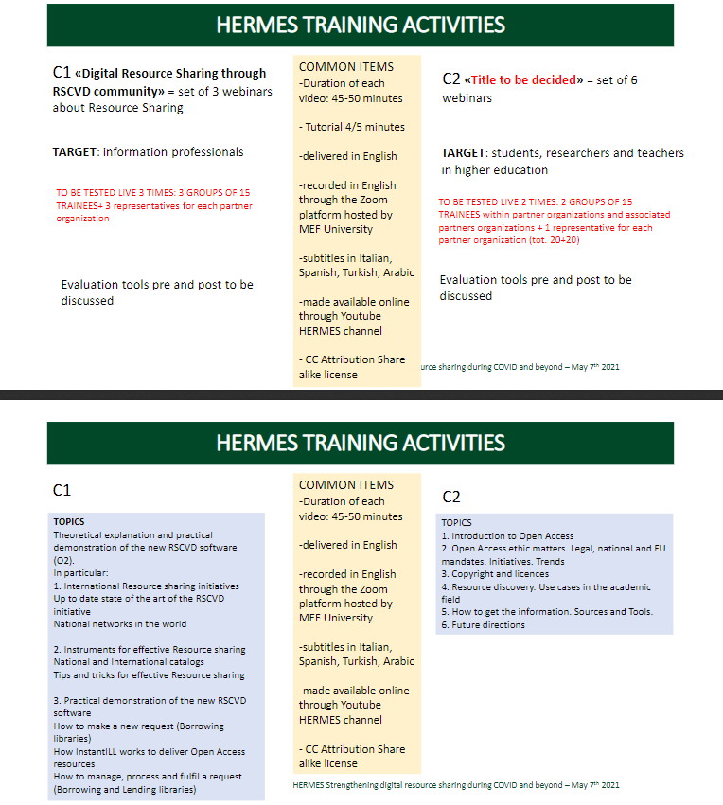
Trainig Scheme
Notes:
Everything started by creating the training scheme. A schema was designed following the objectives in the project document, and first of all, suitable trainers for the C1 and C2 target groups were determined. Then, with the group meetings attended by the trainers, it was decided what should be included in the training kit apart from the content in the project document.

Slide 4
What is the content of the training KIT?
There are Two Different Contents for Different Groups in the Training KIT
Content Available to Partner Institutions Only
Questionnaire
Evaluation Reports
Instructor Biographies
Course Description Forms
Presentation Templates
Draft Documents
Public Content
YouTube Videos
Infographics
Course Description Forms
Notes:
Initially, as the training committee, we thought there would be only one training kit. We were thinking of planning trainings accordingly and uploading the video recordings of the training sessions to the YouTube channel, and our work would be completed. However, in the project's next steps, it was realized that a content kit should be available for the Training Committee only and a second content open for public access. And now, we have two different training kit content for various purposes.

Slide 5
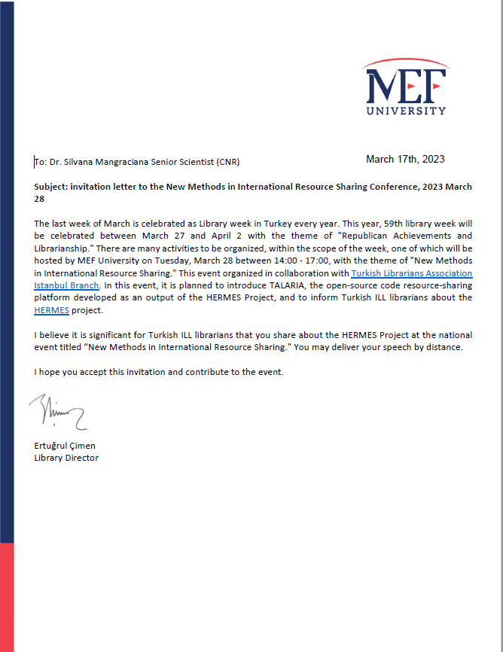
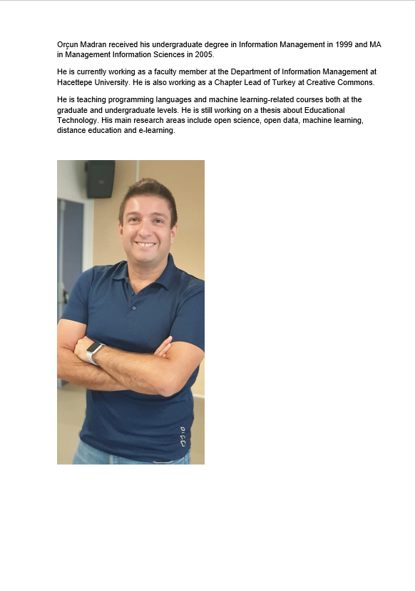
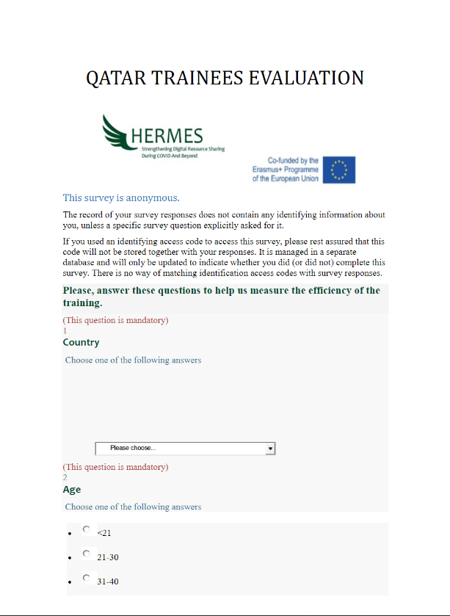
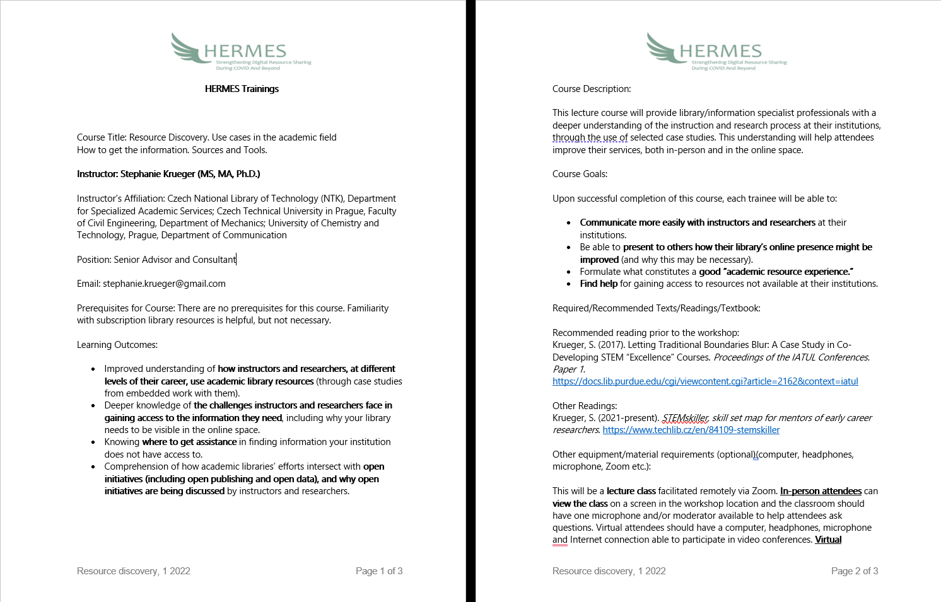
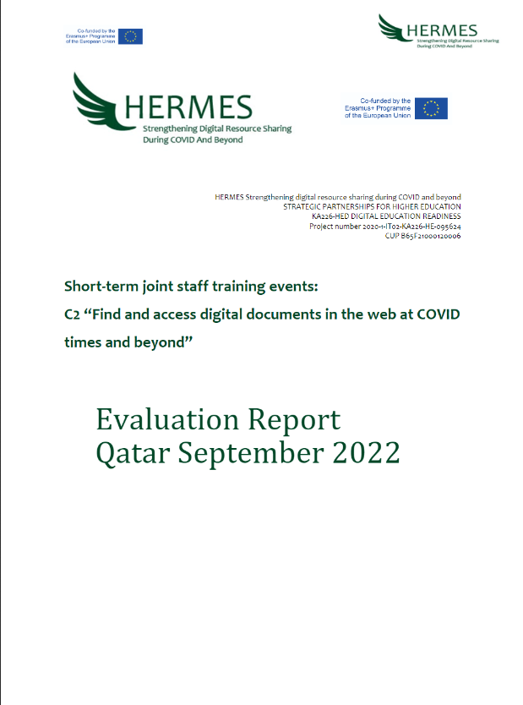
Content Available to Partner Institutions Only
Questionnaire
Evaluation Reports
Instructor Biographies
Course Description Forms
Presentation Templates
Draft Documents
To do List
Notes:
Let's have a look in detail at the content of the first training kit, which is available training committee and the project partners only.
Surveys exist for different target groups, such as instructors, and trainees. We have already conducted these three surveys to evaluate the Hacettepe, Qatar, and Istanbul training sessions.
The evaluation reports were formed by analyzing the results of the surveys. These reports will be used to improve the quality of the following training activities and identify trainees' training needs.
The instructor biographies also exist in the training kit. The biographies promote the instructors, focus on their expertise, cover contact details and bring detailed information about their backgrounds.
Course Description Forms one of the essential parts of the kit. These forms contain critical information such as the content of the course, information about the instructor, the objectives and possible outcomes of the training, and reading lists.
Presentation templates, which are designed to create an institutional form, prevent confusion, and create a unique perception, are also included in the kit.
Some documents used during this training period are also included in the kit to be used as a draft while planning the training sessions in the future.
I specifically marked this last item as red. While preparing this presentation, I realized that, as the training committee, we still need to create the to-do list, which is the most crucial part of the kit. We have to prepare this list and add it to the kit as soon as possible.

Slide 6
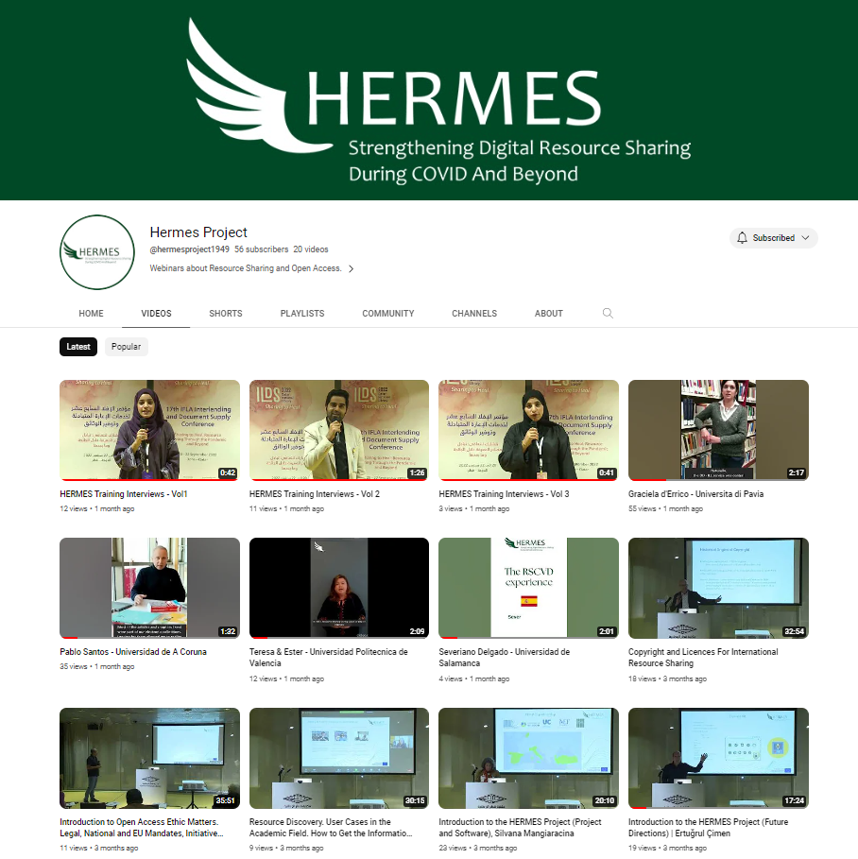
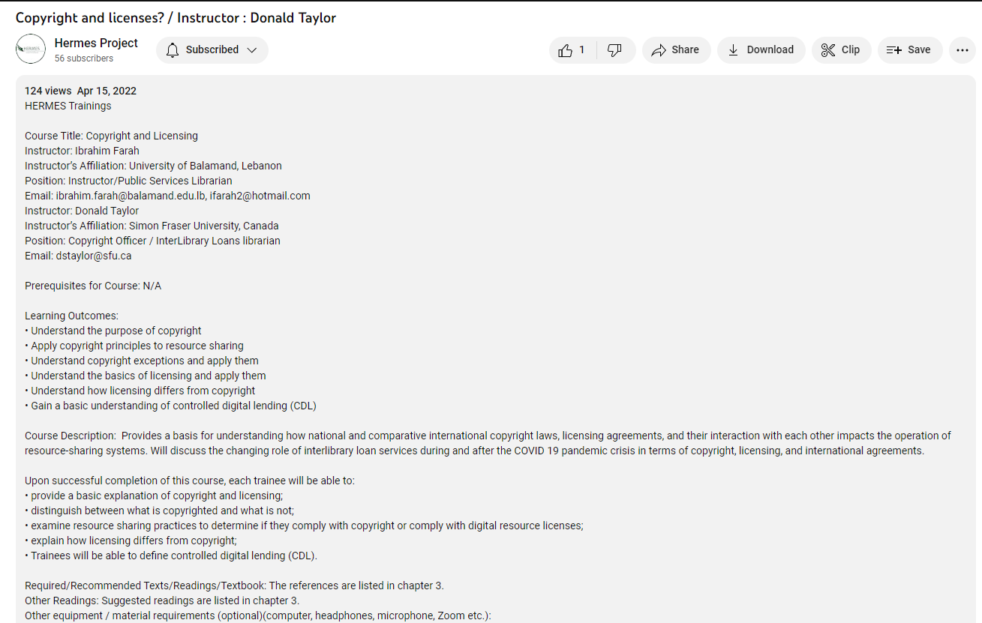
Public Content
Course Description Forms / Reading Lists
Infographics
YouTube Videos
Notes:
Infographics: Specially designed infographics were prepared for each training session held at Hacettepe University. In these infographics, the topics given in each training session, the objectives of the training, and the expected outputs to be achieved are schematically explained. In addition, these infographics have been added as covers to training videos on YouTube.
Videos: It was planned to produce 7 YouTube videos at the beginning. Currently, there are more than 25 video recordings on the YouTube channel of the HERMES project. We are planning to add nearly 15 new videos. Arabic, English, Italian, Spanish, and Turkish subtitles are added to the Hacettepe training videos. I would like to mention that adding subtitles in different languages is much more complicated than expected.
Description forms: As I mentioned before, Course Description Forms are included both in the kit that partners have access to and in videos that are accessible to everyone. In this way, people who watch the videos can also access more information about the content of the training, as well as a reading list and more.

Slide 7
T H A N K Y O U
CONNECT AND SHARE
Notes:
In conclusion, Participating in the HERMES project has been an excellent experience for us as MEF Library staff. We are part of a much broader professional network than 3 years ago and are excited to share what we learned from this project.

