Slide 1
MEF LIBRARY'S RESOURCE SHARING ACTIVITIES DURING COVID-19
INTRODUCTION
IPEK YARAR / MEF University, Technical Services & Social Media Librarian
yarari@mef.edu.tr
Turkey, Istanbul / Maslak, 34396
Notes:
First, I would like to start my presentation by introducing myself. I am Ipek, and I work for MEF University in Turkey. Until 2022 I was a user services librarian, and my areas were circulation & reference services, interlibrary loan services, and social media for libraries. Now, I am working as a cataloger and I am also responsible for social media post activities of the library. Some of you know me from HERMES Project and the RSCVD initiative. In the past, we had several online meetings and I am so happy now to meet with you in person. Today I would like to tell you about our journey with Interlibrary Loan Services at MEF University Library. What we did do, and what were our challenges and opportunities?

Slide 2
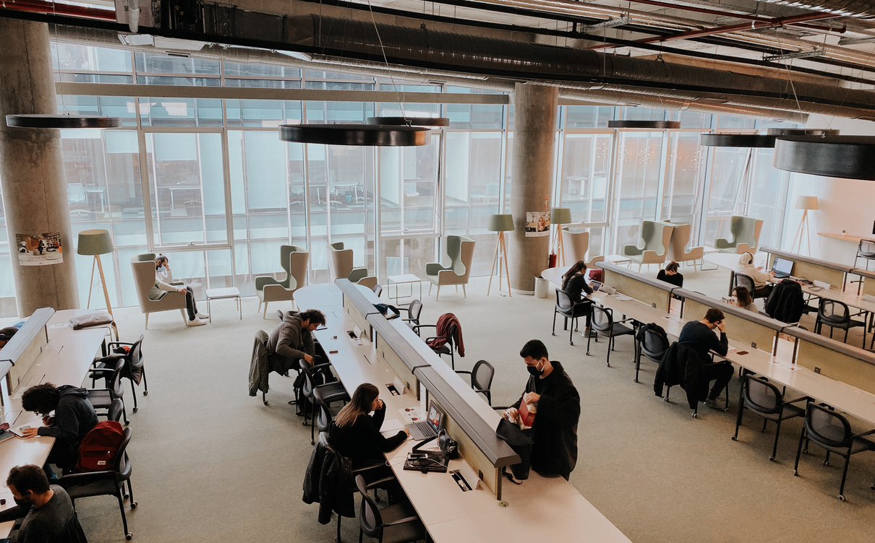
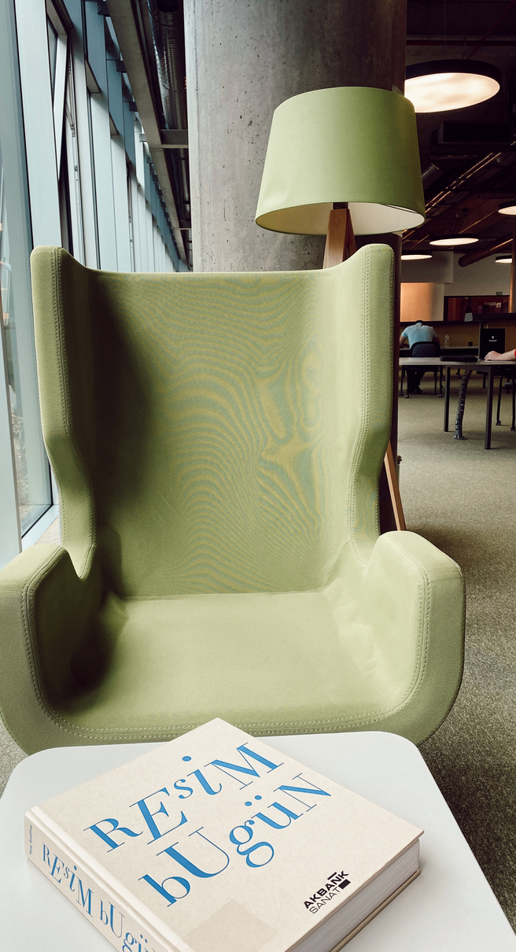
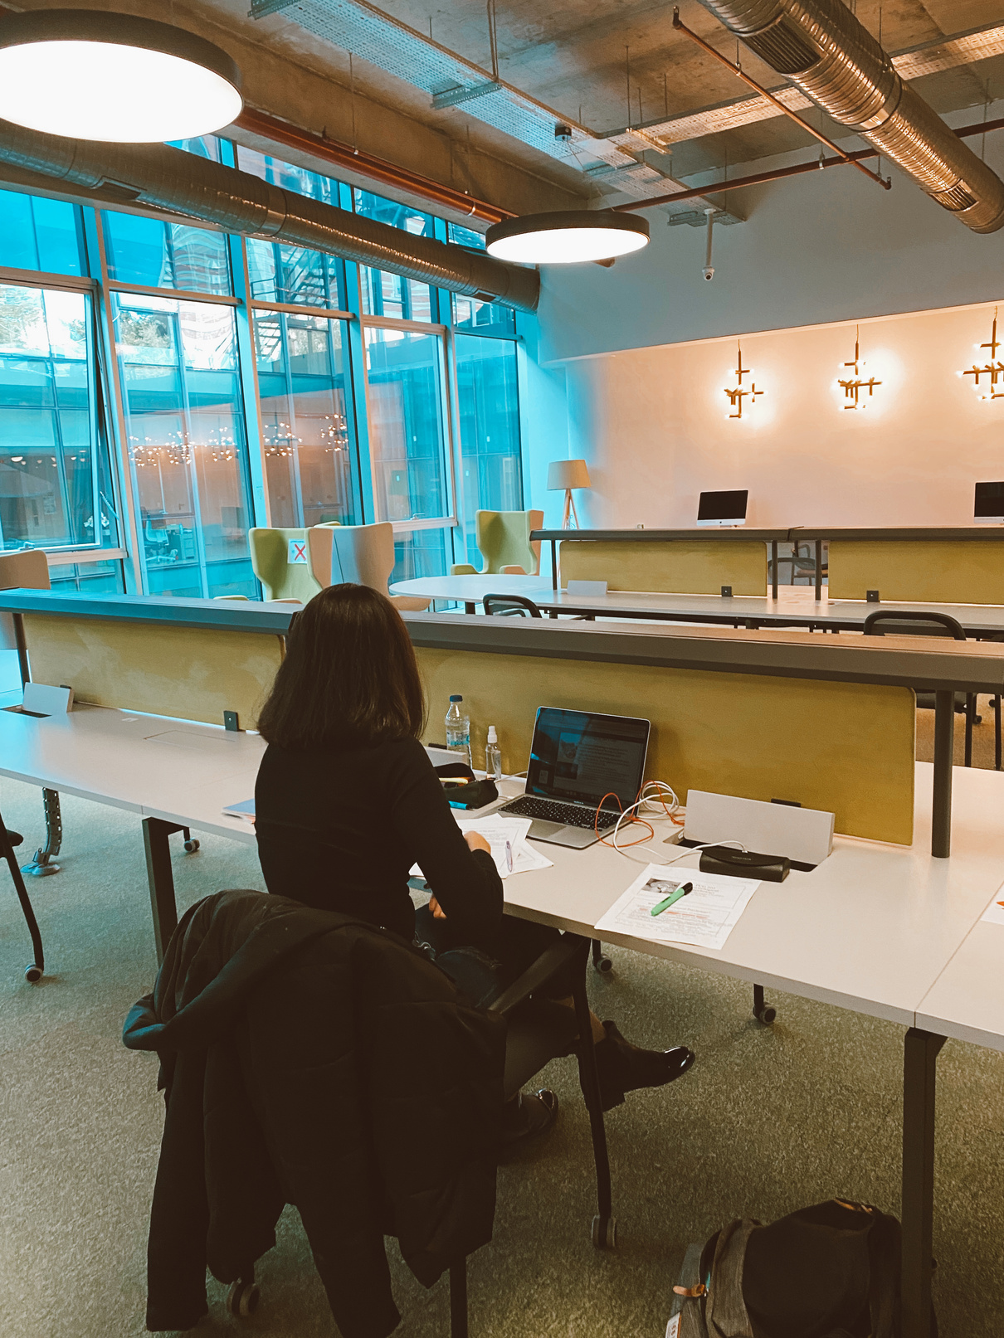
MEF University Library
(MEF Library)
Modernist
Collaborator
Libertarian
Notes:
The main framework of the presentation is based on the MEF Library. MEF Library has an identity of being modernist, libertarian, and collaborator. With its technological infrastructure and collaborative staff, MEF Library easily adapted to the pandemic period with all its institutional capabilities. MEF University continued its uninterrupted communication with its users via social media during the pandemic period. Thanks to its flipped learning model, the institution has provided uninterrupted remote comprehensive services to its users with its vast e-resource collection.

Slide 3
02
Coronavirus Pandemic in Turkey
#TBCORONAVIRUS
In March 2020-2022,15 million cases and nearly 10,000 lost of our citizens to this disease. As of April 26, 2022, the coronavirus measures in Turkey were eased, with the number of cases falling below 1000 just before I arrived. I hope it going as well as.
Notes:
We can recall 11 March 2020, the first coronavirus case in Turkey. At that time, all the companies, schools, state departments, and universities closed. All of the country's population stayed home, waiting to see what was going to happen. Coronavirus cases increased day by day. Throughout the entire pandemic period, Turkey has experienced four peak periods. In March 2020-2022,15 million cases were recorded and we lost nearly 10,000 of our citizens to this disease.

Slide 4
03
How The Coronavirus Has Affected Turkey’s Higher Education and Academic Libraries
(e.g. MEF Library)
TIME TO ONLINE EDUCATION FOR EVERYONE
Support to the library management of the institution during the pandemic process. (Budget, Technology, Incentive and other possibilities)
Support of library management.
Librarian's support to the user.
Notes:
So how was the reaction from higher education institutions? For this, let's first look at the steps MEF University took. MEF University started to take precautions just before the first coronavirus case in Turkey was seen. Therefore, work was carried out first regarding hygienic measures taken for our health. Afterward, there were online training rehearsals held in the preparatory classes so that the education could continue uninterrupted in the case of a possible closure. Taking advantage of the Flipped Learning training model and the rehearsal measures it had taken before, MEF University started its online education comfortably after YÖK closed its educational institutions. MEF University has been the first institution to create online education in Turkey at the beginning of the pandemic.
In addition to all these, MEF University has never spared its support for its students and its staff and has offered its moral and material support to all its staff. It quickly provided all the technological infrastructure and approval to its employees. These have been a valuable feature of MEF University Library from other academic libraries and have been a motivating factor for local and international cooperation. These three items you see on the screen are a chain, and the lack of a link has the power to affect the whole process.

Slide 5
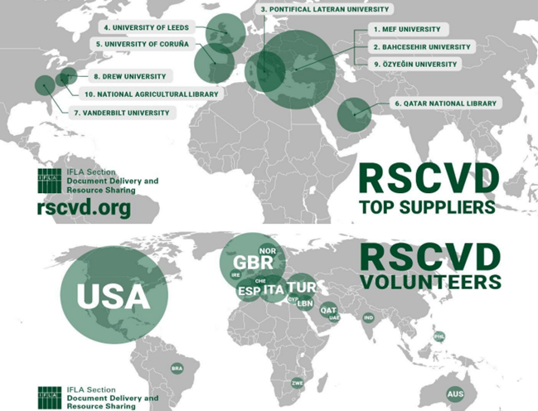
04
MEF University Library in RSCVD initiative during the COVID-19 pandemic.
Goals: This service is a pilot project run by and dependent upon volunteers. Our intention is to continue this service for at least as long as access to library collections is restricted in any part of the world.*
When: 21 April 2020 – ….
From Whom: By volunteer librarians, 8 of whom work in the Turkish University Libraries.
To Whom: Researchers from around the world.
*https://www.ifla.org/news/resource-sharing-during-covid-19-rscvd-tool-launched/
Notes:
Locally, these happened in Turkey. However, there have been more critical developments globally, and as the MEF Library team, we are proud and happy to be a part of these developments. In the first months of the pandemic, as of April 2020, an international cooperation initiative was launched under the leadership of the Resource Sharing Document Delivery Committee of IFLA. The aim of this initiative, called Resource Sharing During Covid-19, was to provide resources to researchers worldwide throughout the pandemic period and to protect scientific studies as much as possible from the adverse effects of the pandemic. For this purpose, 8 University Libraries from Turkey volunteered to support this initiative. Thanks to the MEF Library Director being a part of this committee, we were one of the first institutions to hear about this initiative.

Slide 6
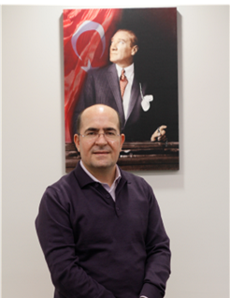
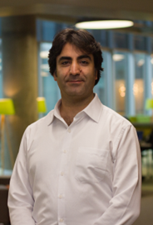
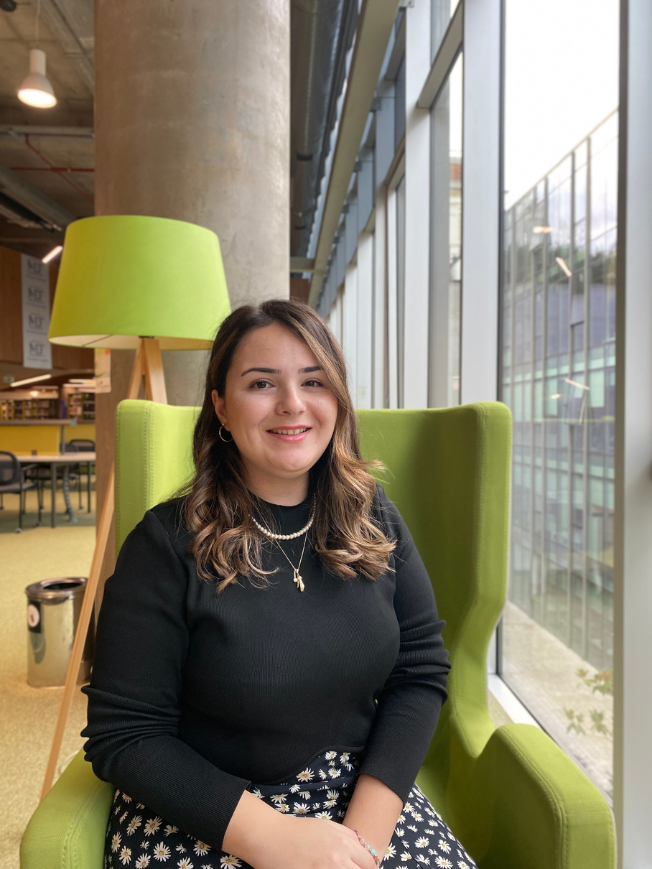
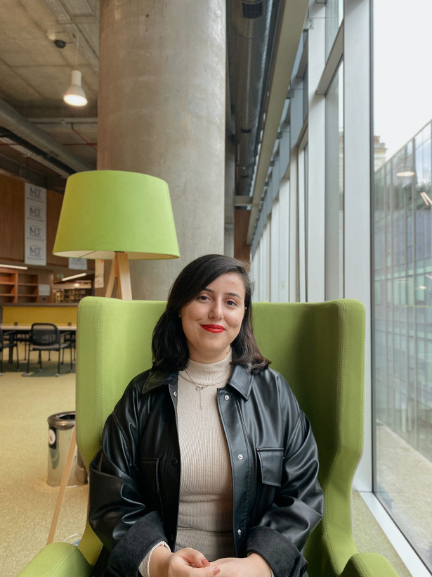
05
Our Team
Ertuğrul Çimen
MEF Library Director
Ramazan Çelik
MEF Library Assistant Director
İpek Yarar
MEF Library, Technical Services | Cataloging & Social Media Specialist
Beyza Yıldırım
MEF Library, Reference Services | Asisstant Specialist
Notes:
To participate in this initiative, I and Ramazan Çelik from the MEF Library team immediately applied as volunteer librarians. Since then, our volunteering has continued without interruptions. You can see the volunteer team for RSCVD. Beyza joined the team about 1 year ago at the end of the corona period. She takes over volunteering from us and continues to work uninterruptedly.

Slide 7
06
MEF LIBRARY STATISTICS
1900+
Number of
Submitted Items
30+
Number of
Requested Items
Notes:
This team has submitted over 1900 items to researchers worldwide since the initiative was founded. The team also requested more than 30 items using the RSCVD platform.

Slide 8
07
Our Motivation!
1
Thanks to the
MEF University
Representing
Turkish Librarianship
.
Notes:
In the first four months of the initiative, we became the country and library that provided the most resources to the world. After that, we always kept our place in the top 5. There was a question we were always asked. How do you provide so many resources? We had a motivation and goals that fed us. The most crucial purpose of the MEF Library was the need to thank our institution for the support it gave us during the pandemic period. Announcing our corporate name in the international arena and representing it well was a thank you to our institution.
Secondly, we considered this initiative an opportunity to make Turkish Librarianship more visible in the international arena. We saw this opportunity with the MEF Library and other Turkish Librarians.

Slide 9
08
How Did We Succeed?
We did not stick to working hours!
Special adjustments we made to our discovery tool.
Positive return on investment in e-resources over print.
Notes:
So, how did we manage this period properly? As the Resource Sharing team, we work hard and timelessly. We continued to work on weekends and evenings. This allowed us to respond to requests quickly. With custom adjustments to our discovery tool, we promptly accessed all open access resources with a single search engine.
Our investments in our e-resources bring us an advantage.

Slide 10
THANK YOU
DO YOU HAVE ANY QUESTIONS?
yarari@mef.edu.tr
+90 532 651 5825
library.mef.edu.tr
@mefkutuphane
@ipekyrr
Notes:
I want to finish my presentation by thanking all RSCVD volunteers. There will always be difficult moments in the world. This is a challenge brought by human nature. The important thing is how much we support each other in these challenges and how fast and solution-oriented we act. As Turkish librarians, we always keep soldiering on for the advancement of science.
Thank you for listening to me. If you send your questions and comments to my e-mail address to avoid wasting your time, I will get back to you as soon as possible.

