Slide 1
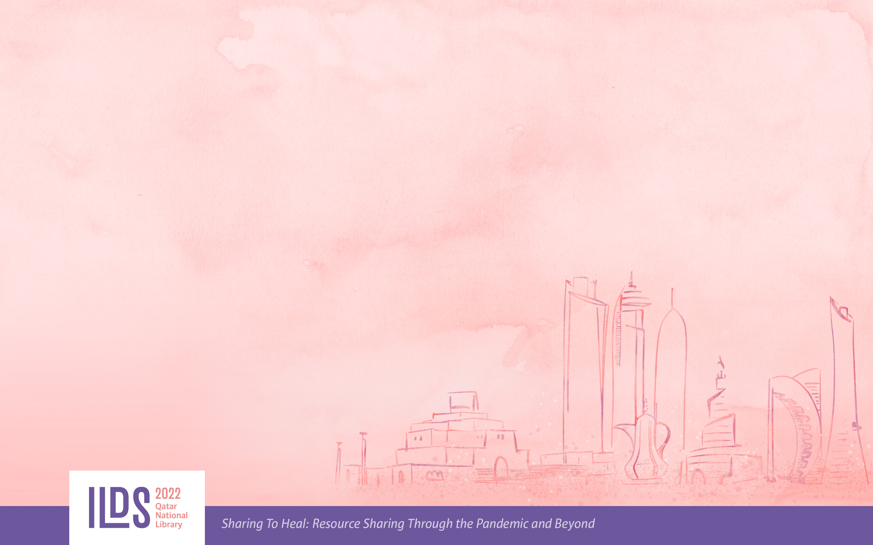
A New Chapter; connecting, collaborating, and contributing
Ertuğrul Çimen
Library, MEF University
Europe Regional Division, IFLA
FAIFE Advisory Board, IFLA
1

Slide 2

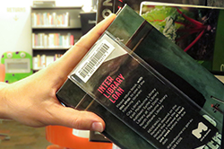
Power of Sharing
Contribution to the profession and society
More interaction and collaboration
Aiming to access more sufficient resources to share with more users
Improving the qualification of services
Better networking
Improving professional skills
Improving self-confidence
Professional development and better career planning
Professional satisfaction
R E P U T A T I O N
https://www.melbourne.vic.gov.au/community/libraries/finding-things/Pages/interlibrary-loans.aspx
17th IFLA Interlending and Document Supply Conference
Sharing to Heal: Resource Sharing Through the Pandemic and Beyond
Notes:
Many years ago (16 years) when I was working as a director at an academic library, I feld that I needed to do more for my profession and users. While I was looking for suitable methods for this, I realized that taking part in an NGO was the best way. In 2006, I joined Anatolian University Libraries Consortium (ANKOS), the most active NGO of academic libraries in Turkey. This gave me a unique opportunity to work in the resource sharing field. With a group of friends, we decided to do something new in Turkey, and we developed KITS, the first online resource sharing platform for academic libraries, and launched in 2008.

Slide 3


New Services
Interlibrary Loan Tracking System for Academic Libraries (KITS)
ANKOS Staff Exchange Program
ANKOS Academy
N A T I O N A L S E R V I C E S
17th IFLA Interlending and Document Supply Conference
Sharing to Heal: Resource Sharing Through the Pandemic and Beyond
Notes:
The establishment of the Collaboration Group under the roof of ANKOS triggered academic libraries to work together. Thanks to the awareness created by the collaboration group, academic libraries began to be more willing to work together at the national level, and professional training programs and staff exchange programs were created in the following years. These national services have been used for many years. Some of these practices were not only national projects but also turned into regional projects with the support and participation of the countries in the region.

Slide 4

New Vision
New Goals
Internationalization
Diversity
Multi Culturalism
Sustainability
Transparency
Global Advocacy
Borderless Study
Innovation
G L O B A L I S A T O N
17th IFLA Interlending and Document Supply Conference
Sharing to Heal: Resource Sharing Through the Pandemic and Beyond
Notes:
The successful results achieved at the national level needed to be shared at the global level, this led me to collaborate with IFLA and encouraged me to be a part of an international network. Of course, I had new goals such as multi-task study, innovative thinking, a proactive approach, collaboration and sharing, continuous improvement, multiculturalism, transparency, global advocacy, and sustainability.

Slide 5

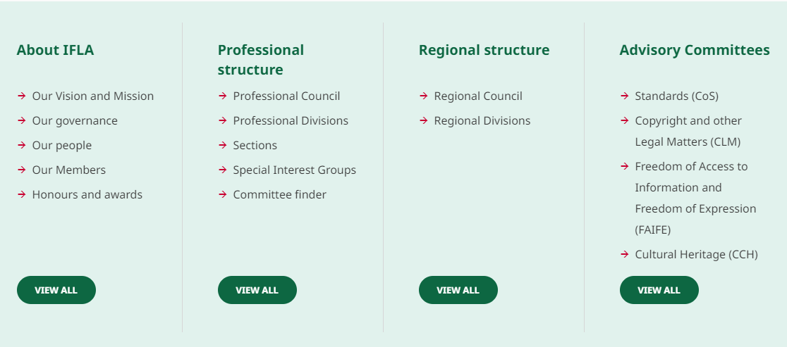
17th IFLA Interlending and Document Supply Conference
Sharing to Heal: Resource Sharing Through the Pandemic and Beyond
Notes:
As you can see on the screen, it has a very well designed and strong organizational structure. District committees, advisory boards, working groups, and advocacy groups are a powerful, corporate organization that brings together hundreds of information professionals and librarians who work to advocate in accordance with IFLA's traditions and values. While advocating around the world, IFLA encourages many librarians to take part in activities voluntarily.

Slide 6
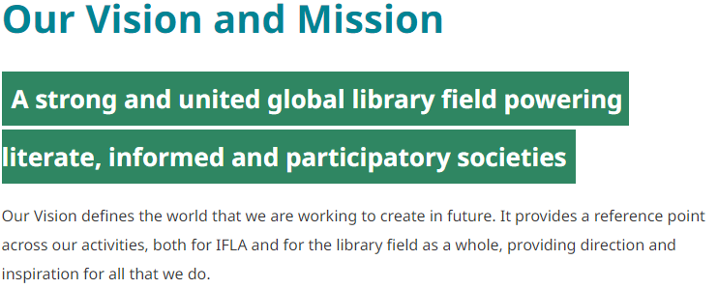
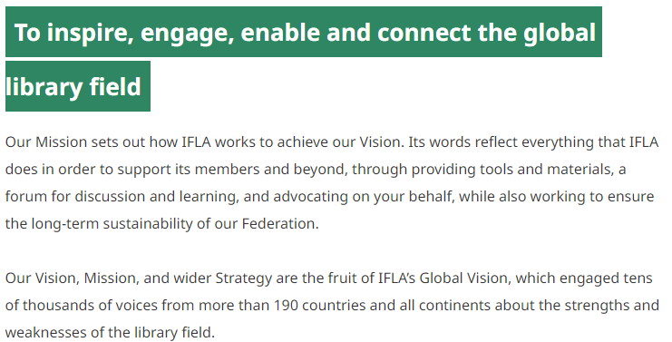
17th IFLA Interlending and Document Supply Conference
Sharing to Heal: Resource Sharing Through the Pandemic and Beyond
Notes:
Now let's look at IFLA's vision and mission that impressed me. Here, I specifically marked the statements that caught my attention. As you can see, some of the expressions “creating the world of the future” are exciting for all of us. Especially the possibility of contributing to this process is really dazzling. On the other hand, as a librarian who has focused on cooperation and collaboration for many years, being able to communicate with other stakeholders is always very attractive for every librarian.

Slide 7
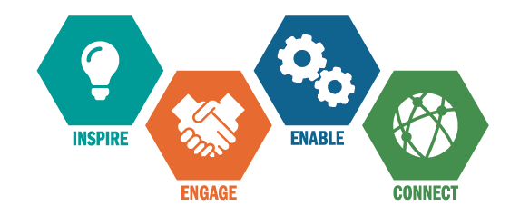
Core Values
In pursuing our Vision and Mission, IFLA embraces the following core values:
the endorsement of the principles of freedom of access to information, ideas and works of imagination and freedom of expression embodied in Article 19 of the Universal Declaration of Human Rights
the belief that people, communities and organisations need universal and equitable access to information, ideas and works of imagination for their social, educational, cultural, democratic and economic well-being
the conviction that delivery of high-quality library and information services helps guarantee that access
the commitment to enable all Members of the Federation to engage in, and benefit from, its activities without regard to citizenship, disability, ethnic origin, gender, geographical location, language, political philosophy, race or religion
17th IFLA Interlending and Document Supply Conference
Sharing to Heal: Resource Sharing Through the Pandemic and Beyond
Notes:
As your working environment, the stakeholders you communicate with, and your professional network develop and change, it is possible for you to have the opportunity to work in more and different areas. It is extremely meaningful that IFLA's core values ​​include human rights, access to information, censorship, freedom of expression and thought, equality, which are the main fields of work of the FAIFE advisory board, of which I have been a member for a while. On the other hand, it is remarkable that IFLA ignores the determinants such as ethnicity, gender, location, language, political preference, religion, and evaluates the members within the framework of equality.

Slide 8
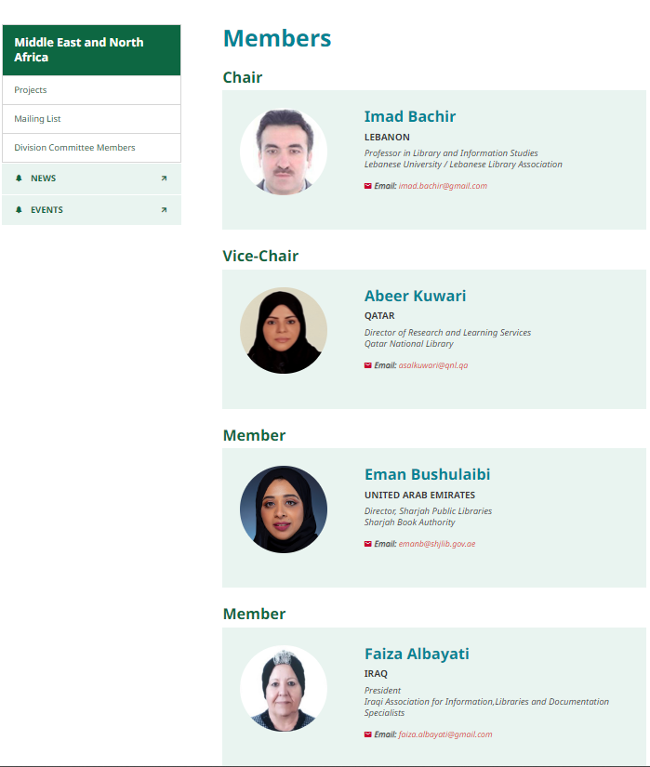
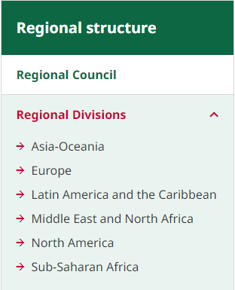

https://www.sentinelassam.com/editorial/glocalization-transcends-think-global-act-local-525530
17th IFLA Interlending and Document Supply Conference
Sharing to Heal: Resource Sharing Through the Pandemic and Beyond
Notes:
Regional committees formed, as a part of the restructuring efforts of IFLA in recent years. As a part of IFLA's global advocacy approach, regional committees aim to better understand regional issues, and find solutions to regional problems from a global perspective. The work of the regional committees established within the scope of the 2019 – 2024 strategic plan (targets) has started to yield its first results, and we are expecting these studies will become more comprehensive in 2023.

Slide 9
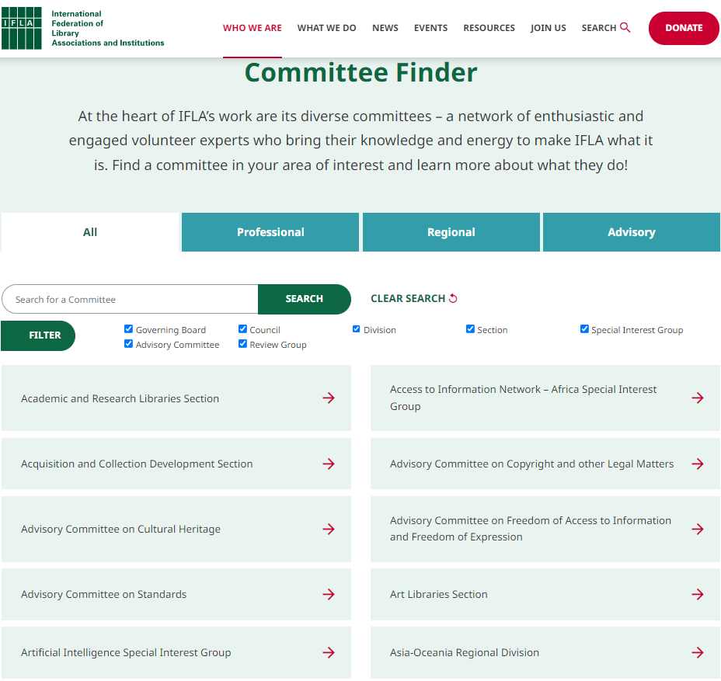
Committees & Working Groups
17th IFLA Interlending and Document Supply Conference
Sharing to Heal: Resource Sharing Through the Pandemic and Beyond
Notes:
In addition to its global advocacy role, IFLA has committees and working groups operating on many issues, such as creating a global network, supporting and promoting creative and sustainable studies, supporting the development of library education, and contributing to the improvement of its quality, setting professional standards, etc. Volunteers from different parts of the world serve in these committees and working groups. These volunteers are the main human resource of IFLA.

Slide 10
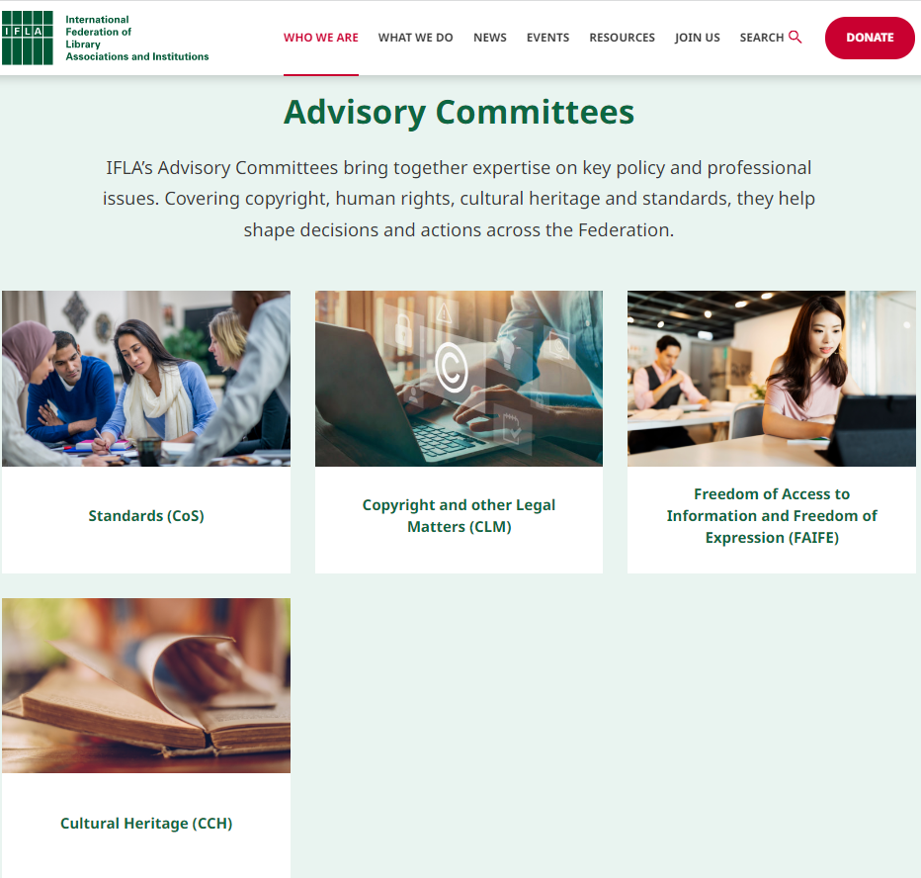
Advisory Committees
17th IFLA Interlending and Document Supply Conference
Sharing to Heal: Resource Sharing Through the Pandemic and Beyond
Notes:
IFLA’s Advisory Committees bring together expertise on key policy and professional issues. Covering copyright, human rights, cultural heritage and standards, they help shape decisions and actions across the Federation.
For example, FAIFE, of which I am a member, works on access to information, human rights, censorship, prevention of information pollution, access to reliable information, protection of cultural heritage, and similar issues. Finally, the FAIFE committee prepared an evaluation report for IFLA GB regarding the ongoing war in Ukraine and then held a well-attended session on this subject at IFLA WLIC. In this way, FAIFE tried to mediate both the global librarianship community to be informed about the subject and the librarians in the countries that are party to the problem to make their voices heard.

Slide 11
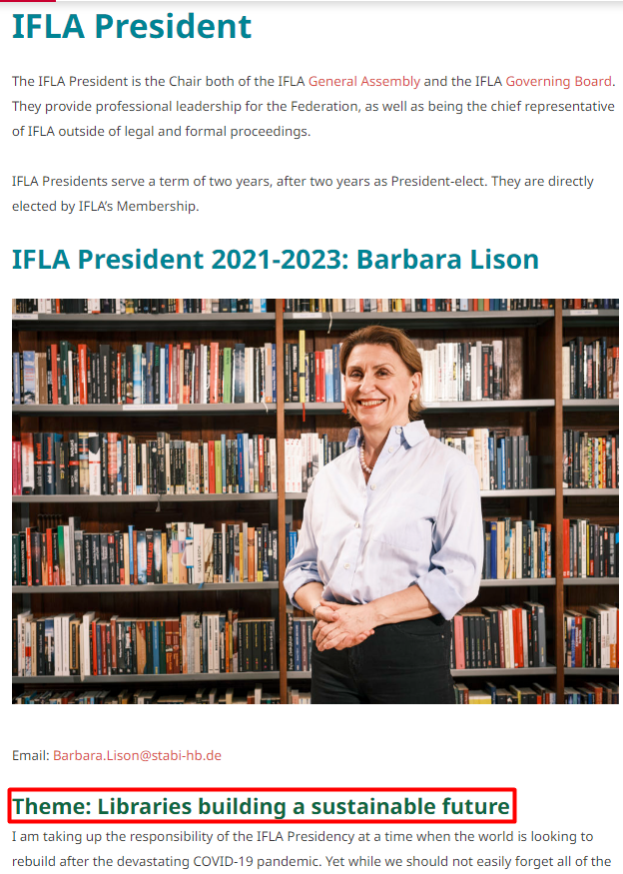
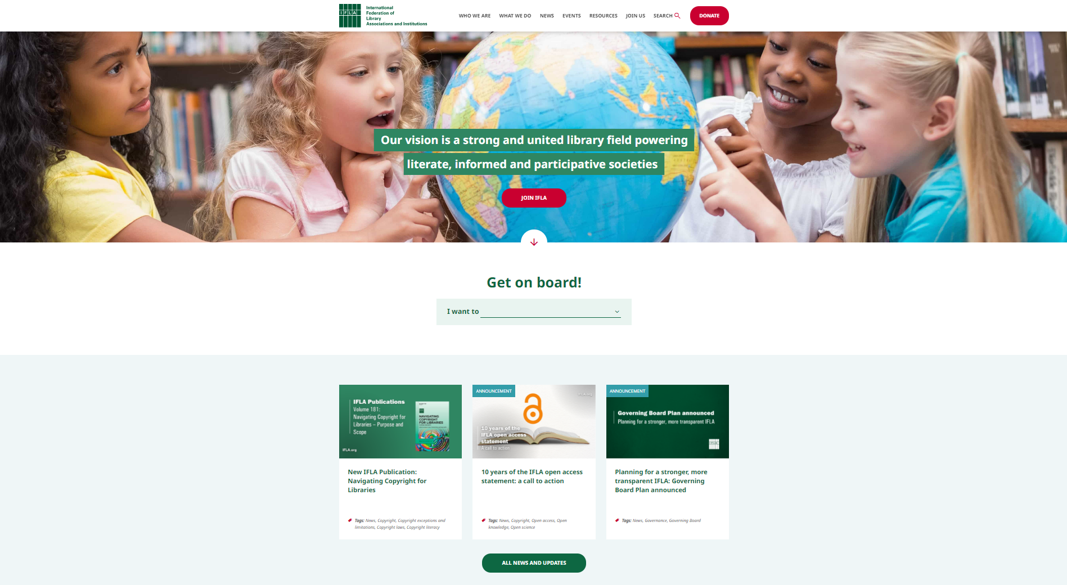
Priorities / Theme
17th IFLA Interlending and Document Supply Conference
Sharing to Heal: Resource Sharing Through the Pandemic and Beyond
Notes:
The prior areas of IFLA determine by strategic plans, and these issues are included in these plans. On the other hand, the Presidents determine the issues that they will highlight during their two years term. The current President Barbara Lison has identified the theme as “sustainability” and has been advocating for this issue and striving to raise awareness throughout her tenure. The topics I mentioned as IFLA Values in the previous slides are the permanent working areas of IFLA.

Slide 12
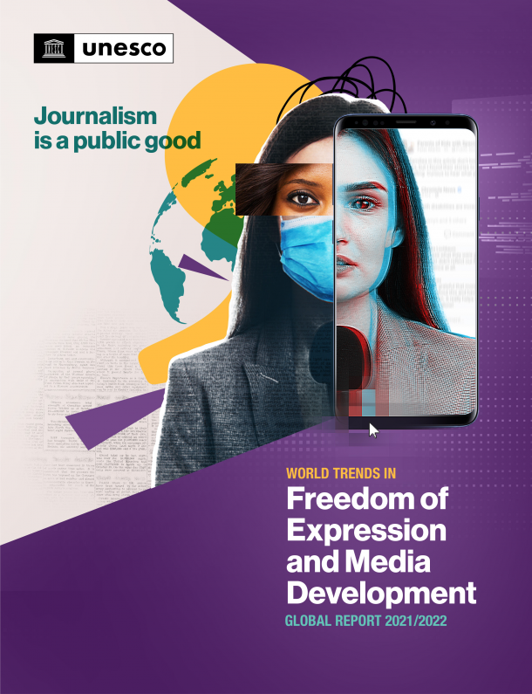
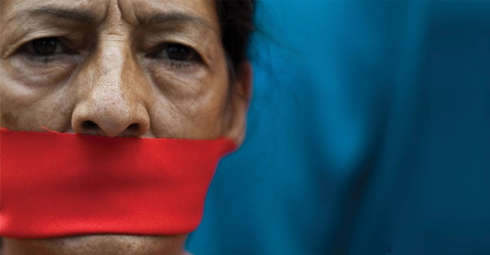
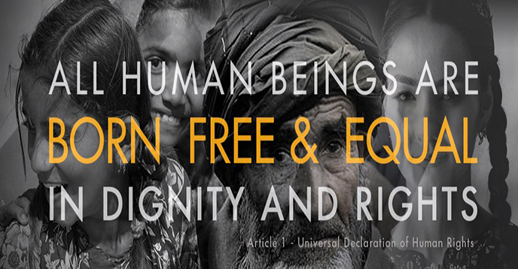

https://en.unesco.org/70years/freedom_of_expression
Challenges
https://es.unesco.org/node/315523
https://www.unesco.org/en/world-media-trends
https://www.freepnglogos.com/pics/copyright
17th IFLA Interlending and Document Supply Conference
Sharing to Heal: Resource Sharing Through the Pandemic and Beyond
Notes:
IFLA has deep-rooted historical problems to focus such as access to information, reliable information, censorship, human rights, freedom of expression, protection of cultural heritage, and copyrights. In addition, IFLA needs to be agile and find proactive solutions to the new problems that directly affect libraries and librarians, such as personal data security, open science, climate change, and the energy crisis. IFLA should be as prepared as possible for unexpected global adversities such as pandemics, natural disasters, etc. that humanity faces. I would also like to point out that political actions and their effects on libraries at the global level are among the problems that IFLA has to deal with.

Slide 13
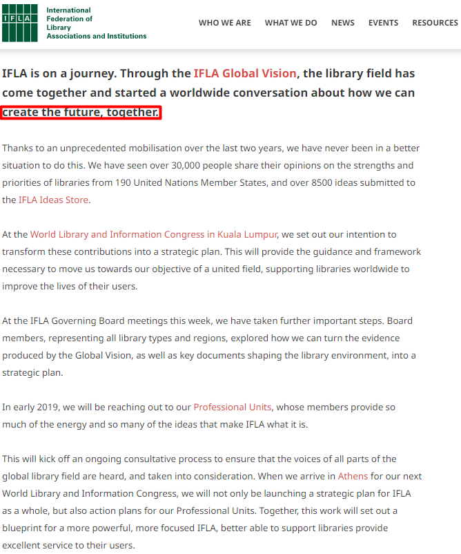
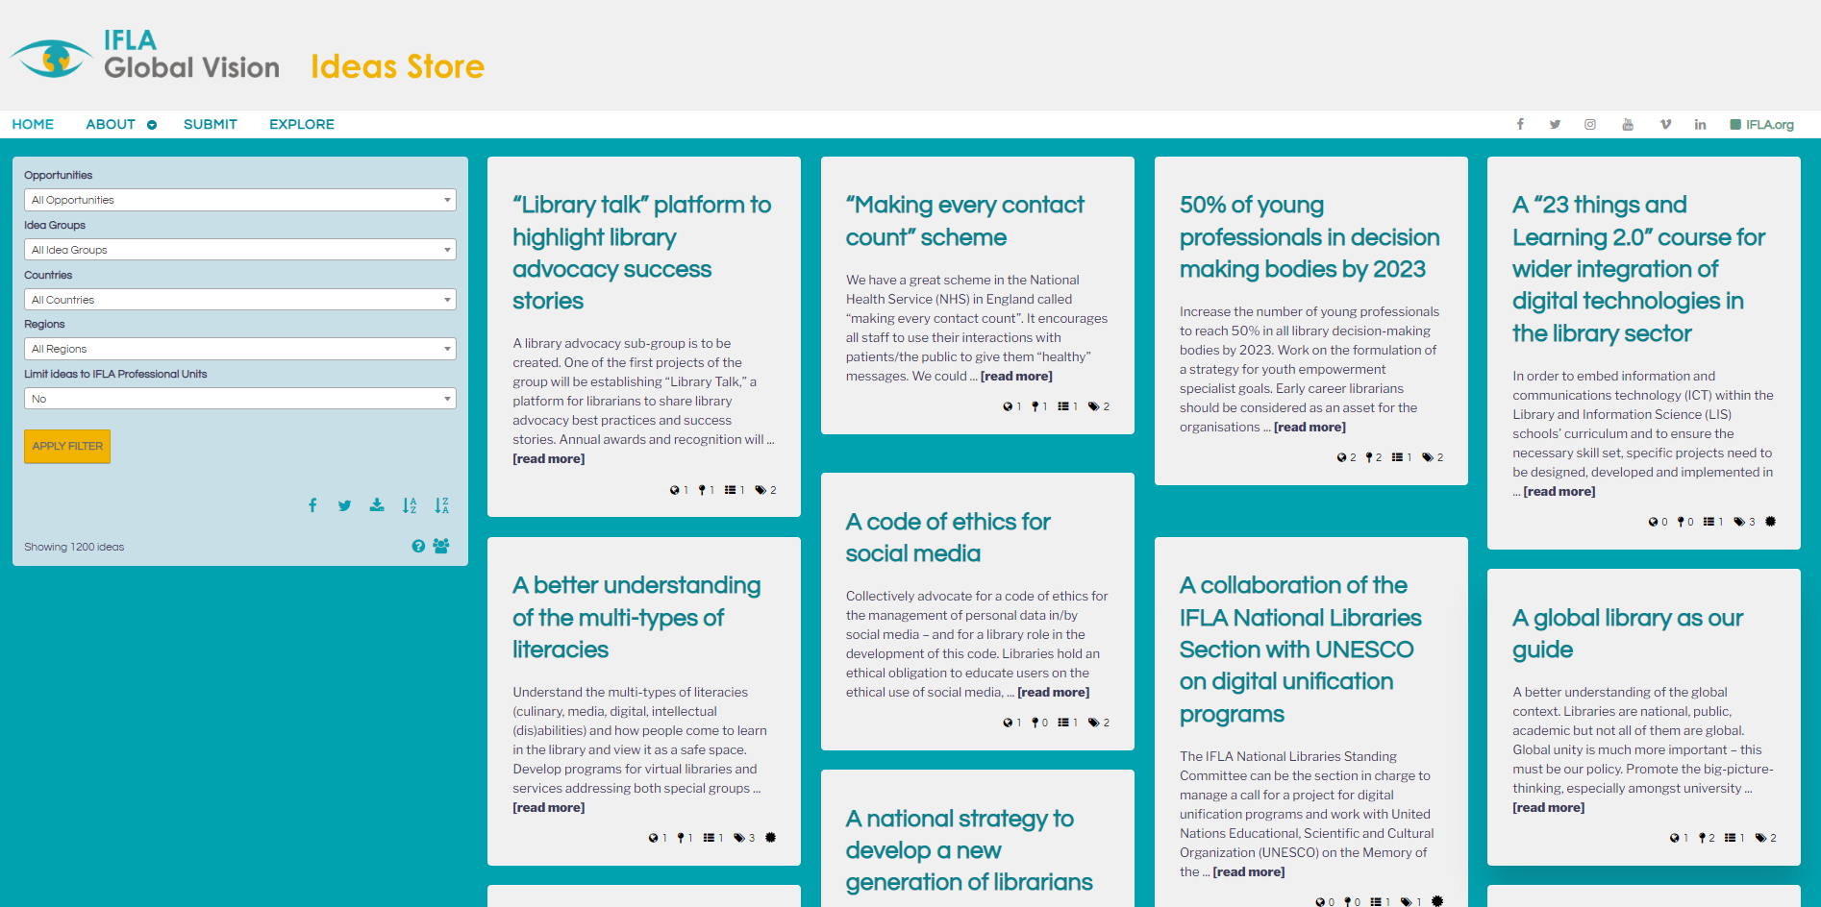
Designing Future / New Scenarios
17th IFLA Interlending and Document Supply Conference
Sharing to Heal: Resource Sharing Through the Pandemic and Beyond
Notes:
Librarians and professional organizations need to write new scenarios for future re-planning, review of foresight, and possible positive and negative developments. It is necessary to review and revise the traditional methods used to solve problems from the past and make predictions for issues we have not encountered yet. The “IFLA Ideas Store”, with more than 8500 submitted ideas from 190 United Nations member countries, is a sufficient initiative. The initiative is a successful example of the global inclusion and diversity approach of IFLA. It made a significant contribution to the 2019-2024 strategic plan. However, some ideas were delayed or slowed down because of the pandemic and then some of the institutional issues that IFLA faced. Now, It should be our common goal that these efforts gain momentum again.

Slide 14
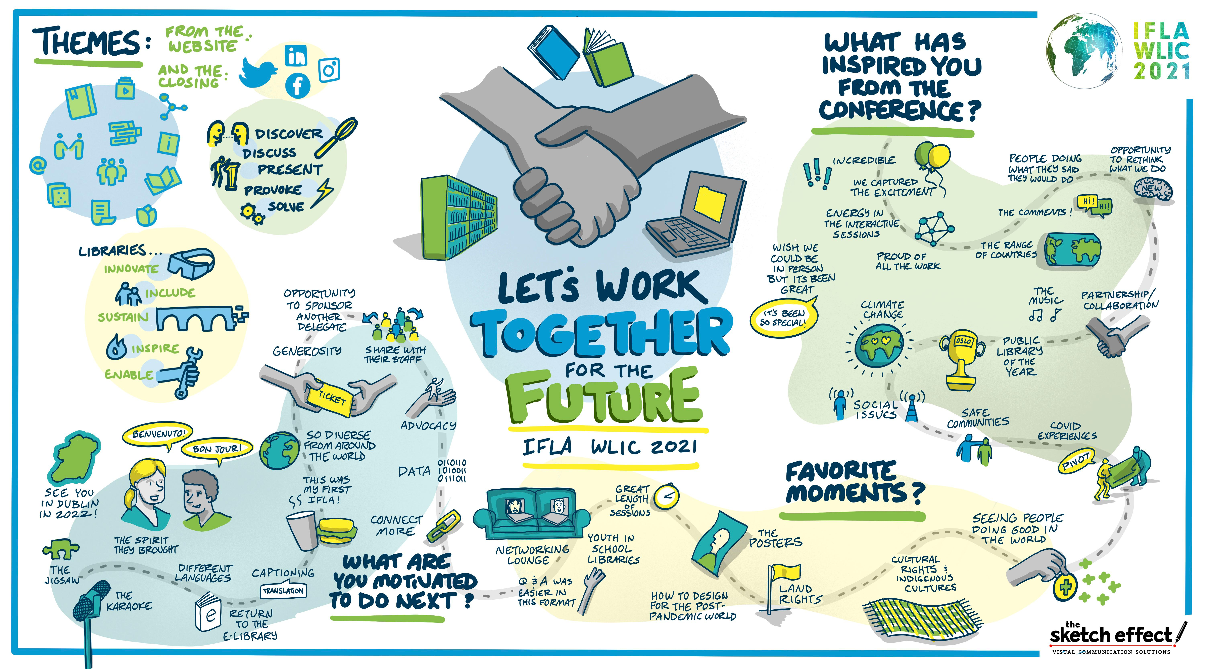
Do Better
17th IFLA Interlending and Document Supply Conference
Sharing to Heal: Resource Sharing Through the Pandemic and Beyond
Notes:
We, librarians can do better at the national, regional, and global levels. For this, first of all, we should participate more in the activities of national and international non-governmental organizations, fulfill our duty of control over them, and encourage these structures to be more transparent and even put pressure on this issue. On the other hand, we must move institutions away from status quo approaches and force them to change their cumbersome structures. Our priorities should be to encourage individuals, institutions, and countries to cooperate and collaborate more by developing a stronger and more effective communication network. Thus, a more accessible institutional structure and diversity can be achieved.

Slide 15
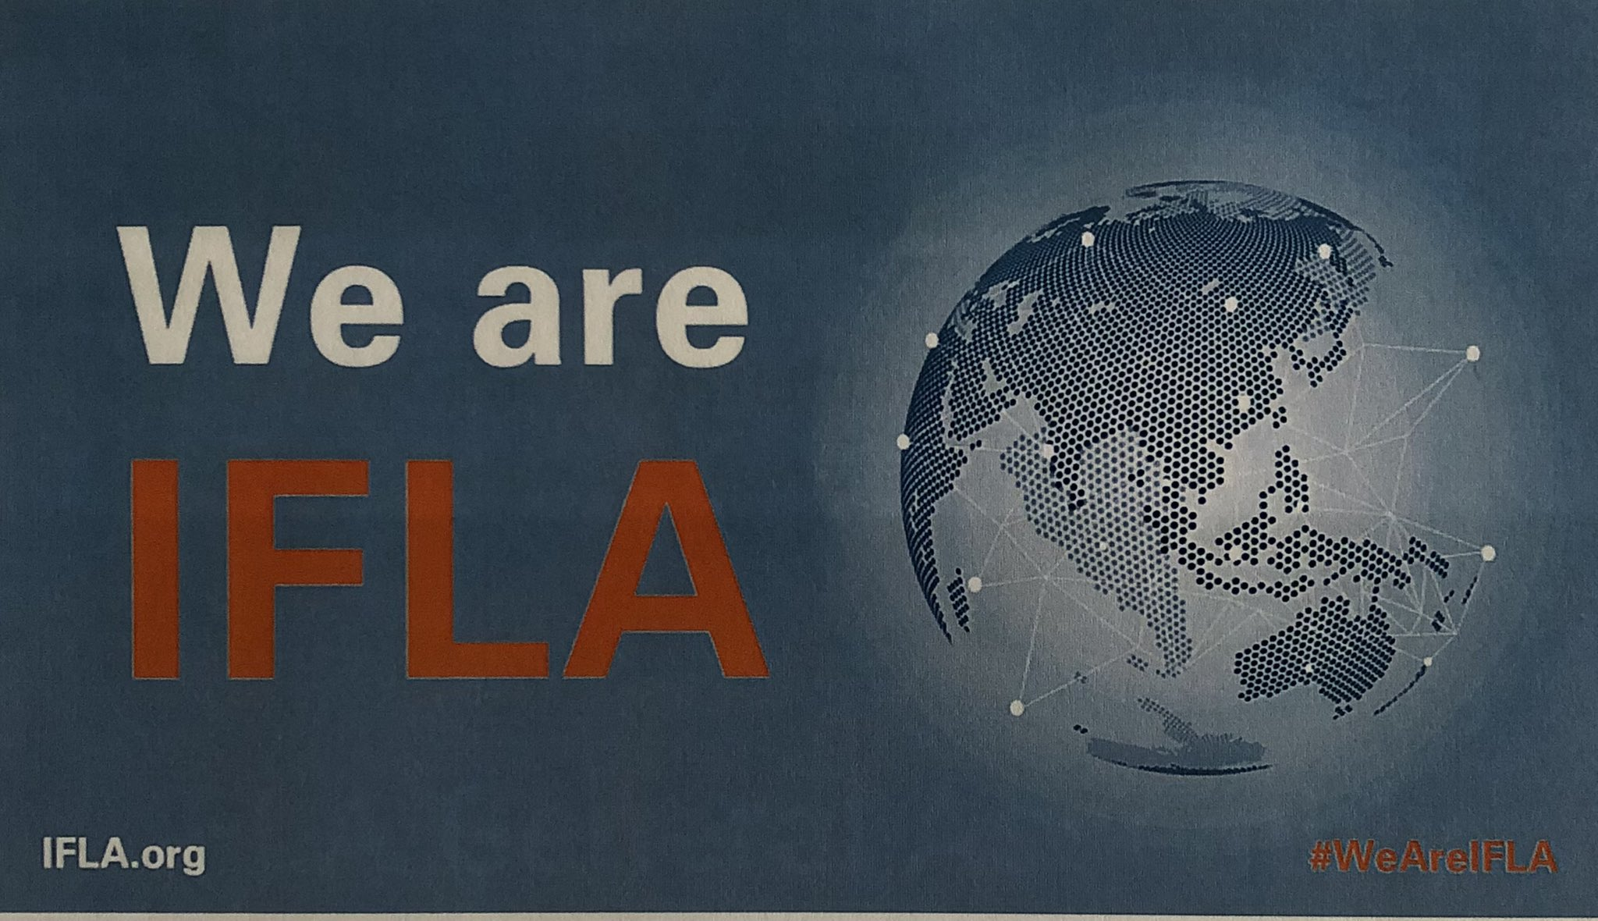
We Are IFLA
17th IFLA Interlending and Document Supply Conference
Sharing to Heal: Resource Sharing Through the Pandemic and Beyond
Notes:
Yes, librarians as well as humans, have very different and very complex problems to deal with. However, we, the representatives of a profession almost as old as human history, can be a part of the solution by supporting our professional organizations, especially IFLA, by contributing to their work. We are IFLA.zümün bir parçası olabiliriz. Biz IFLA’yız.

Slide 16
Thank You
Ertuğrul Çimen
cimene@mef.edu.tr
https://www.ertugrulcimen.com/
References, etc.
https://www.ifla.org/
https://www.unesco.org/en
Reference 3

